Slide 1
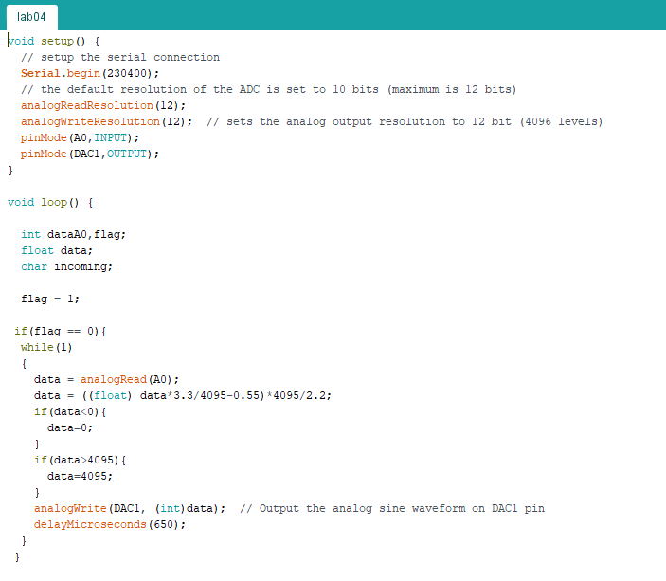
Introduction to Robotics and Mechatronics
GROUP 2.5
Benson Chalethu
Pietro Griffa
Ingvar Groza
PostLab 04
Q1

Slide 2
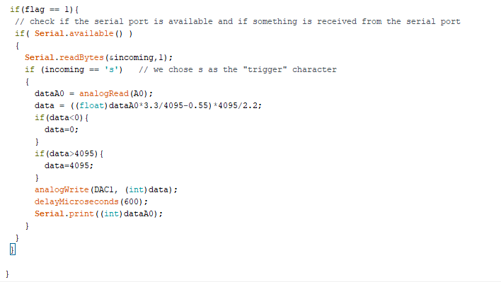
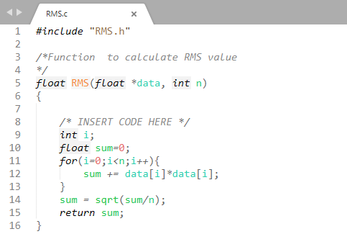
Q2

Slide 3
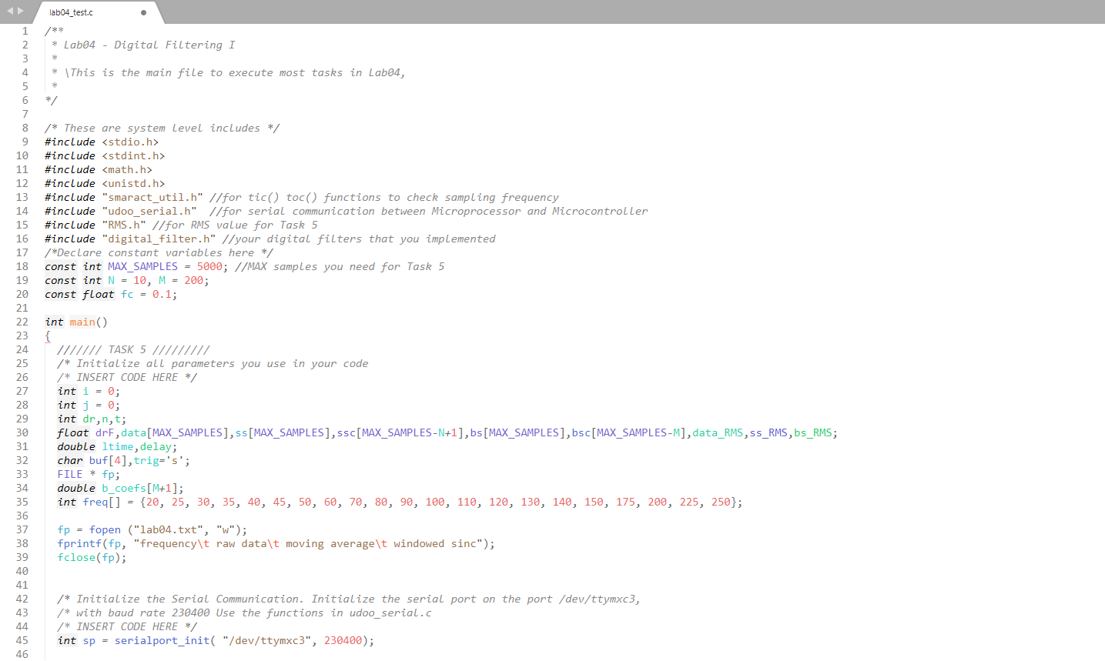
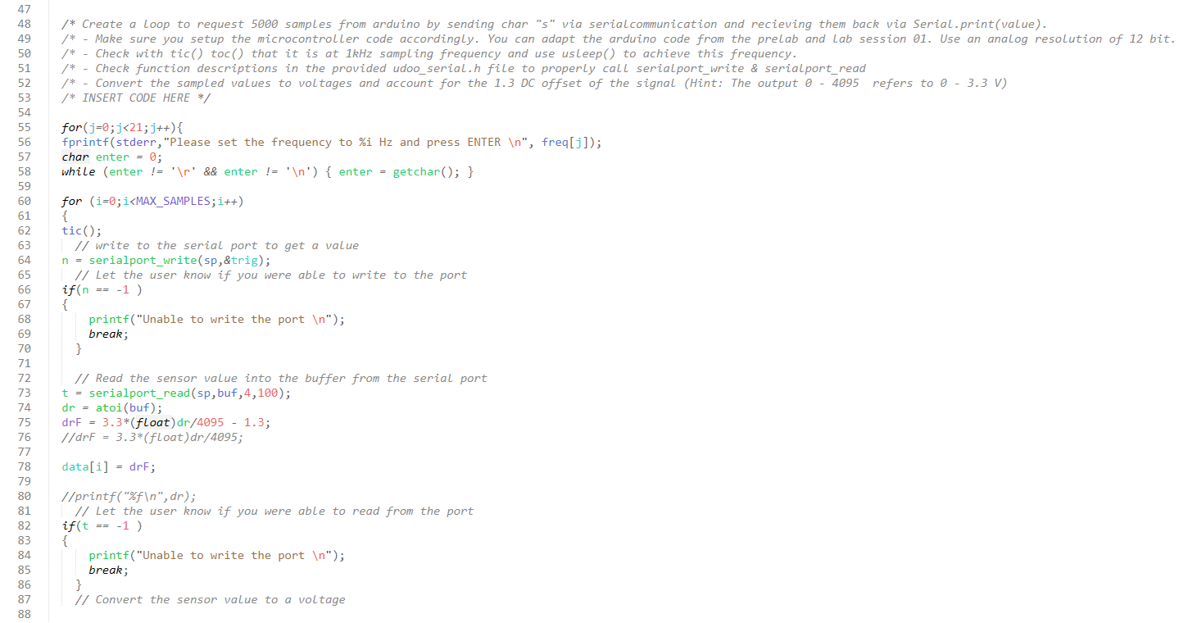
Q3

Slide 4
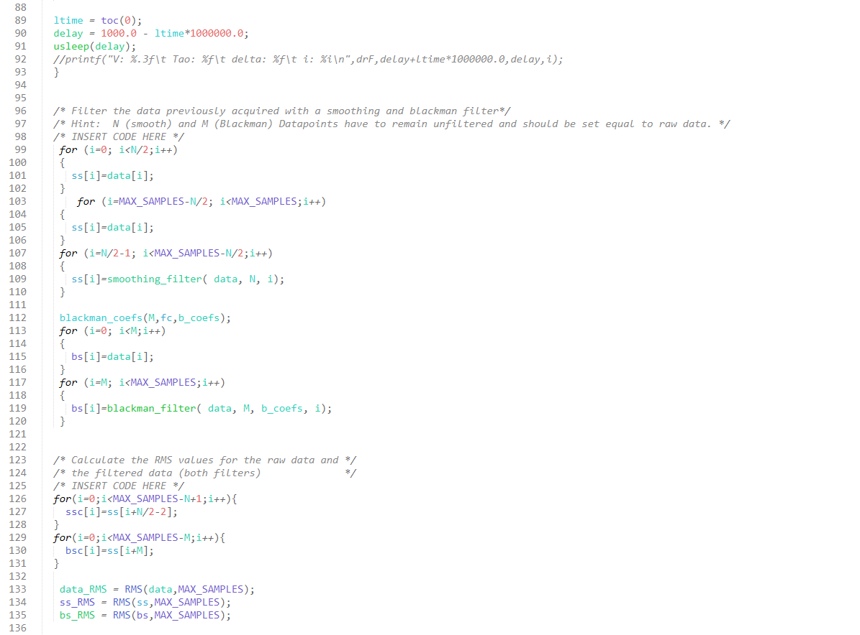
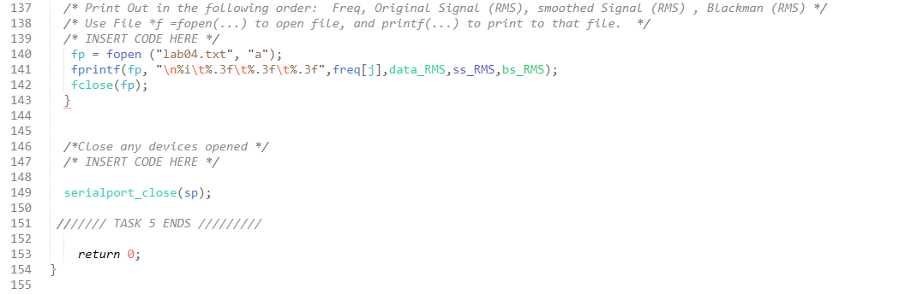

Slide 5
We notice that, as expected, the cutoff frequency of the windowed-sinc filter (100 Hz, 0,1 if expressed as a fraction of the sampling frequency) falls at the one-half amplitude point (0,2/2 = 0,1). We use 0.5 instead of the standard 0.707 (-3dB) used in analog electronics and other digital filters because the windowed-sinc's frequency response is symmetrical between the passband and the stopband.
In these graphs, though, we can see that the RMS never reaches 0: this is due to the fact that part of the datapoints in the filtered signals remains equal to the raw data.

Slide 6
